Slide 1
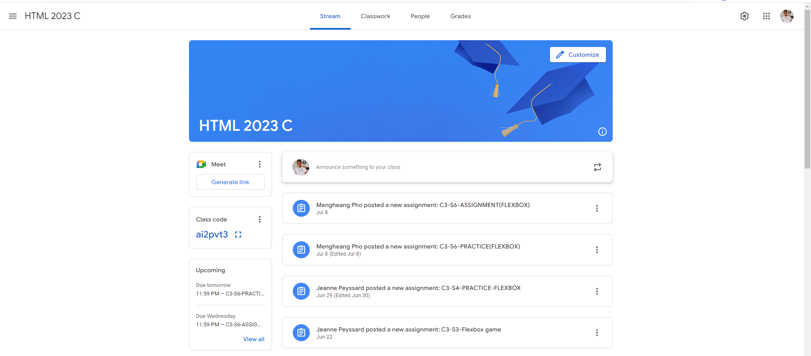
Identify root components of website below

Slide 2
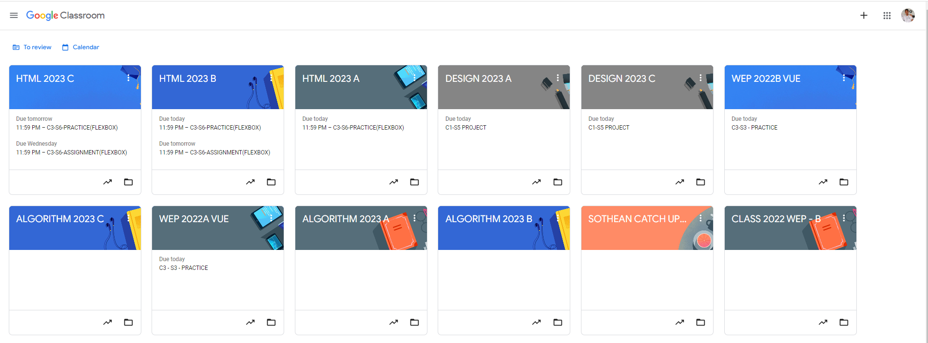
Root div
- Height: 100vh
content
nav
Flex: 0
header
Flex: 0
Flex: 1

Slide 3
The main element:
Content
nav

Slide 4
Navigation
Nav left
Nav middle
Nav right

Slide 5
Main
title
Left
column
Right column

Slide 6
Left column
Item 1
Item 2

Slide 7
Right column
Item 1
Item 2
Item 3
Item 4
Item 5

